Slide 1
Ethical hacking

Slide 2
BeEF (Browser Exploitation Framework)
Bettercap
MITM
Hstshijack
Browser is hooked to beef
Access webcam

Slide 3
002
Set up penetration tester lab
4 section
Network hacking
WEP, WPA, WPA2
Gain access
Post exploitation
Website hacking
How to secure

Slide 4
003
Hacking: gain unauthorized access to system not supposed to access
3 types of hacker:
Black hat: bad
White hat: approved to hack
Grey hat: not approved to hack, will not steal $, etc.
Why:
For job. Secure system from hacker

Slide 5
005
Lab setup (everything (VM) inside 1PC)
Hacking machine (Kali Linux)
Target machine/ website/ netwk
Windows
Metasploitable
VM: Virtualbox or VMWare
Wont lose any functionality
Wont affect host PC

Slide 6
006
Kali has many hacking tools
Custom kali for this course:
Smoother and faster
Extra program not in original Kali
Enable virtualization to run virtual machine.
Check:
Task Manager> Performance > Virtualization: Enabled.
If not enable, restart PC, press F key > Intel Virtual Technology: Enabled (or other wording)

Slide 7
007
Download Vmware program https://zsecurity.org/download-custom-kali/
Follow default setting. Next all the way.
Vmware>File>Open>…
Edit VM settings
Memory: 2GB
Processor: 2
Network: NAT (Host is the router to the VM)
Display: tick Accelerate 3D graphics
Login: root, toor
View > Full screen
If icon looks small (due to high monitor resolution), Display Setting > Scale: 200%

Slide 8
010 Kali Linux basic
Many hacking applications
Home directory
Many workspaces
Dock
Wireless adapter: USB for providing WIFI functionality (comm with other PC)
Built-in wifi adapter:
Cannot use in VM
Not good for hacking
Brand is not impt, chipset is impt
Wireless chipset (processor, brain)
Best: Atheros AR9271 (chipset): Monitor mode & packet injection mode, aircrack NG suite. But does not provide 5GHz wifi
Alfa AWUS036NHA (brand model) (better, longer range. Bad: quite big, visible)
Realtek RTL8812AU (chipset) or AR8812AU?: everything the Atheros AR9271 + 5GHz. Bad: only support recently
Alfa AWUS036ACH (brand model)
Additional functionality: AP mode (add as Access Point)

Slide 9
011 Linux terminal
Can do everything. B4 GUI, is terminal
In many situation, u have ssh or terminal only.
Pwd
Ls
Cd
Man <cmd>, q to exit: full manual page
Clear
-- help (word), -h (letter): short built-in cmd usage summary
Command has options and arguments
Tab auto-complete
2 good websites
Explainshell.com

Slide 10
012 Network Hacking
Need to connect to same network to gain access to other system
3 sections:
Pre-connection attk
Gaining access
Crack wifi key
Post connection attk
Apply to Wifi or wired network
Intercept, capture, modify data

Slide 11
013 Network basic
Connect to network to share resources
Access point/router: only device that has direct access to Internet resource.
Communication: Request/ responses

Slide 12
014
Wireless adapter for WEP cracking and WPA/WPA2 cracking
Add USB Controller to ur VM if it is not added yet. Select USB 3.1. USB2 cannot work.
My wifi chipset is inbuilt into my motherboard, cannot be seen by Vmware. Need to buy USB wifi adapter.
Brand does not matter. Chipset matters.
RealTek RTL8812AU
Atheros AR9271
Wireless adapter requirements:
Monitor mode
Packet injection mode
AP mode
Start kali first b4 connecting wifi adapter.
Select connect to virtual machine in host environment instead of to host.
Ifconfig to see wlan0

Slide 13
015 MAC address
Media Access Control
Physical (hw)
Unique (not true as can be modified)
Assigned by manufacturer
Purpose of changing it:
Increase anonymity (hide identity)
Impersonate other device
Bypass filter
Ifconfig
Ether xx:xx:xx:xx:xx:xx
Must be connected to network to have ip addr
Lo (loopback) does not have
Wlan0 does not have since not connected to wifi AP

Slide 14
Change mac address
Ifconfig <interface_name> down: disable
Ifconfig <interface_name> hw ether <ne:wm:ac:dd:re:ss>: change. May fail if NIC does not allow MAC spoofing or VM with MAC locked by hypervisor.
Y spoofed mac address need to start with 00?
Does not need.
There are rules for first Byte of MAC address
LSb0: 0 (unicast address). Network adapter cannot use multicast address as their own MAC.
LSb1: 1 (locally Administered): Indicate it isnt part of vendor-assigned namespace. Not needed.
Ifconfig <interface_name> up: enable
Change back to original when restart the PC. Only change it in memory. Not changing the actual mac address.
If change back without restarting PC, it is the network manager> To prevent that, do the following:
https://www.youtube.com/watch?v=7AUGQNBCddo
leafpad /etc/NetworkManager/NetworkManager.conf
Add the following inside
[main]
plugins=ifupdown,keyfile
[ifupdown]
managed=false
[device]
wifi.scan-rand-mac-address=no
[connection]
ethernet.cloned-mac-address=preserve
wifi.cloned-mac-address=preserve
service NetworkManager restart

Slide 15
16
Packet flows from source mac to des mac in wired network
iwconfig: configure wireless network interface
Mode: Managed (default) only capture packet that is destinated to it.
The wifi adapter I buy is 3 dBm Tx-Power (2mW) vs video (20 dBm=100mW)
Monitor mode cannot use to surf internet
But for wireless network, u can access all packet as they are in the air. Set to monitor mode. Not all wireless adapter support monitor mode.
Down wireless interface: ifconfig wlan0 down
airmon-ng check kill: kill network manager. Don’t rely on it for internet.
iwconfig <interface name> mode monitor
Up wireless interface: ifconfig wlan0 up
Alternative method:
https://www.youtube.com/watch?v=wiIoR_0epvs
Down wireless interface: ifconfig wlan0 down
airmon-ng check kill: kill network manager. Don’t rely on it for internet.
airmon-ng start wlan0: start monitor mode. The wlan0 will change to wlan0mon
Up wireless interface: ifconfig wlan0mon up

Slide 16
Pre-Connection attack 17 packet sniffing
Enable monitor mode
airodump-ng wlan0: discover all the wireless network around and display useful information. Only 2.4GHz.
airodump-ng --band a wlan0: 5GHz
airodump-ng --band abg wlan0: 2.4GHz + 5GHz. Slightly slower.
ESSID: wireless network name, some has <length: 0>
BSSID: mac address of the wireless network
PWR: signal strength of the power (less negative=more powerful). Can use to estimate how far from it.
Beacons: may change for some
#Data: useful packet (with different IV)
#/s: # packets for the last 10 sec
CH: channel that the network works for
MB: max speed of the network
ENC: encryption used by the network. WPA, WPA2, WPA3, WEP, OPN: Open network
CIPHER: CCMP, WEP,
AUTH: authentication used by network. PSK, MGT, SAE

Slide 17
Pre-Connection attack 18 wifi bands
Bands define frequency range (2.4 and 5GHz)
Not many wifi adapter can see 5GHz and can monitor mode + packet injection mode.

Slide 18
Pre-Connection attack 19 targeted packet sniffing
airodump-ng --bssid 10:62:EB:3C:EC:B9 --channel 4 --write test wlan0: sniff specific network using BSSID, channel and write to file called test.
Top section is same as previous, except now there is only 1 network
Bottom section is the device connected to the network.
STATION: mac address of device
PWR: power of device
Probe: device looking for wat network
Generate 4 files
test-01.csv
test-01.kismet.netxml
test-01.cap (use wireshark to view this one)
test-01.kismet.csv

Slide 19
Pre-Connection attack 20 Deauthentication attack (deconnect device from network)
Ur PC impersonate target device and tells router that it wants to be disconnected
Ur PC impersonate router and tells target device that it is disconnecting target device.
aireplay-ng --deauth 1000000000 -a <target bssid> -c <device mac addr> -D (for 5GHz) wlan0
Running deauth attack
1000000000 large number of packet to run deauth attack for very long.
Pre-connection attack is just to sniff for network and device information + deauth device from network

Slide 20
airmon-ng: change wifi adapter to monitor mode
airodump-ng: discover wifi network, targeted target sniffing, capture packet/ IV
aireplay-ng: deauthentication attack, fake authentication attack, arp replay attack
aircrack-ng: analyse captured IV and crack the key

Slide 21
22 Theory behind Cracking WEP Encryption
WEP: Wired Equivalent Privacy (old encryption (RC4), simple to crack)
Client and router knows the key. They use it (indirectly) to encrypt and decrypt the message.
Weakness is how WEP implement algo.
Random Initialization Vector (24 bits only) is used to generate key stream
IV + key = keystream
Each pkt is encrypted using a unique key stream.
The encrypted pkt is sent together with IV (pre-pended)
Weakness:
IV is sent in clear
IV is too small.
IV will be repeated in busy wifi network -> make WEP vulnerable to statistical attacks. Repeated IV can be used to determine key stream and break the encryption.

Slide 22
WEP password is 5 or 10 or 13 or 26?
64 or 128-bit key
airodump-ng --bssid 10:62:EB:3C:EC:B9 --channel 4 --write test wlan0 wait for #Data to be >100k before trying to crack.
aircrack-ng test-01.cap to crack the wifi network key.

Slide 23
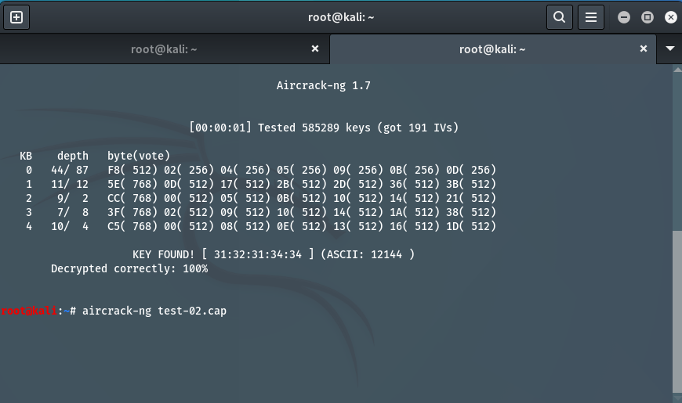
Use 3132313434 as it will always be there. ASCII: 12144 may not be there.
Using 3132313434 or 12144 can both work for the password

Slide 24
Possible problem is not busy network will not generate many useful data. Need to wait very long to have sufficient data.
Solution: Force router to generate new IV by doing fake authentication. Associate with router even though u have not connected to it (know the wifi network key). Don’t ignore me, communicate with me.
airodump-ng --bssid 10:62:EB:3C:EC:B9 --channel 4 --write test wlan0
aireplay-ng --fakeauth 0 –a <wifi_network_bssid> -h <my_wifi_adapter_mac> wlan0
After u do aireplay-ng, the AUTH will be OPN.
To find <my_wifi_adapter_mac>, ifconfig, look at unspec first 6 Bytes (no ether as it is in monitor mode), convert - to :

Slide 25
After associating with router, u can communicate with it and it will not ignore us. Use this communication to force it to generate new IV.
Use arp request replay attack (most reliable and simple)
Wait for an ARP packet
Capture it and replay it (re-transmit it)
Cause the router to produce another packet with a new IV
repeat
aireplay-ng --arpreplay -b <wifi_network_bssid> -h <my_wifi_adapter_mac> wlan0
This method has slow ARP request packet generation rate compared to the video.

